Slide 1

FTS Solutions Group
Empower your value with IT !
18.11.2019

Slide 2
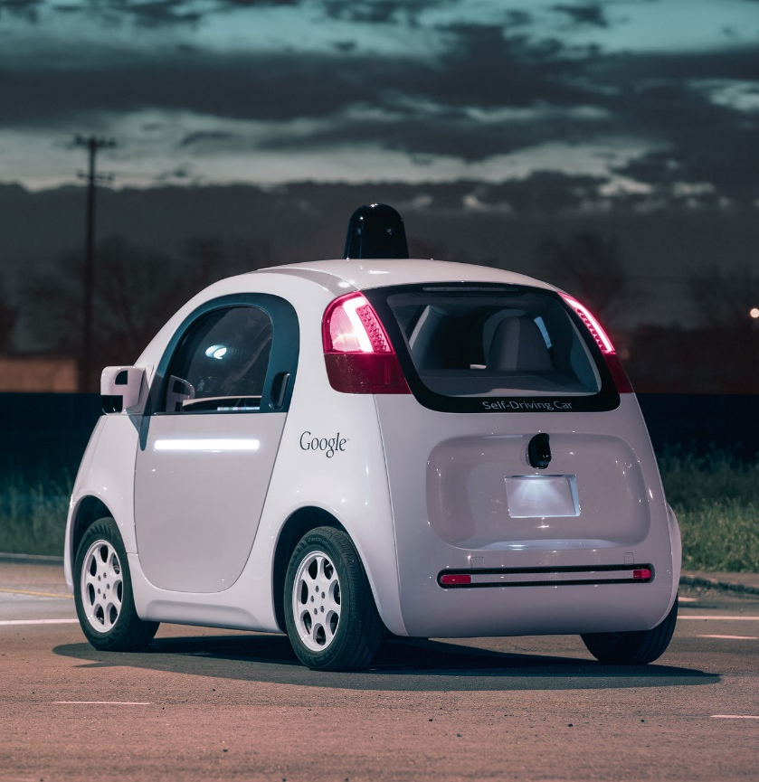


Prepare today for Tomorrow
Move to cloud solutions
Edge device focus banking
Data analytics
Security in every aspect

Slide 3

Our vision - ISA
Innovators at heart
and soul
Smart in the brain
at DHBW Mannheim
Accelerate with our feet bringing financial to the future

Slide 4
about FTS Solutions Group
6 Mitarbeiter in über 5 Städten
FinTech Unternehmen Startup
More than 122 years of life experience

Slide 5
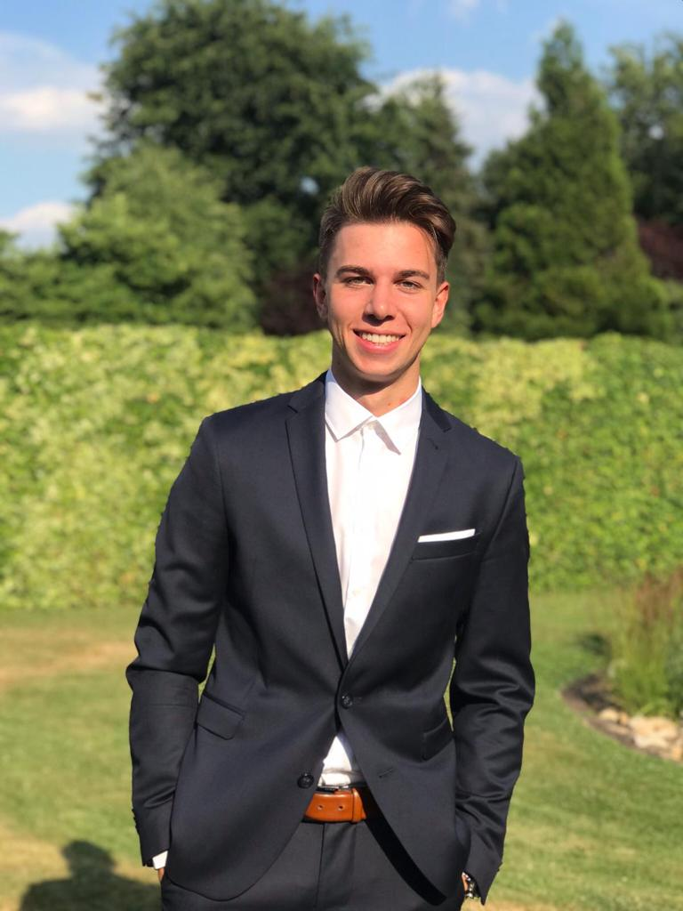
Tom Müller
20 Jahre
Duisburg
Product Owner
Inside Sales Representative
EMEA Marketing

Slide 6
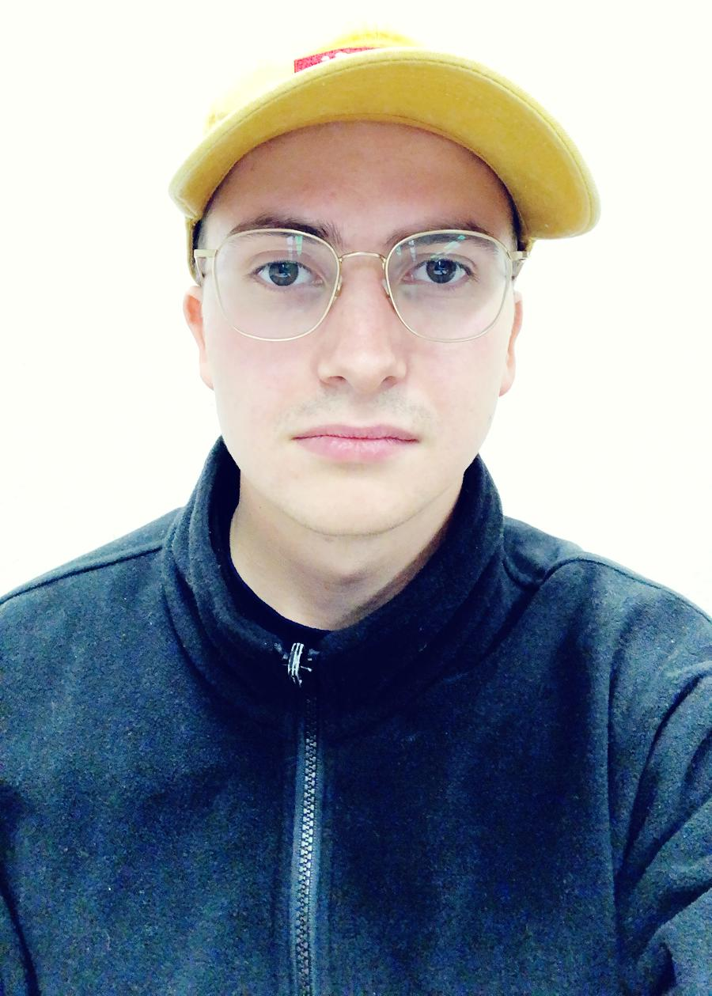
Stephan Lenert
20 Jahre
Karlsruhe
Software Developer
Testing Specialist
CEO of Biketree

Slide 7
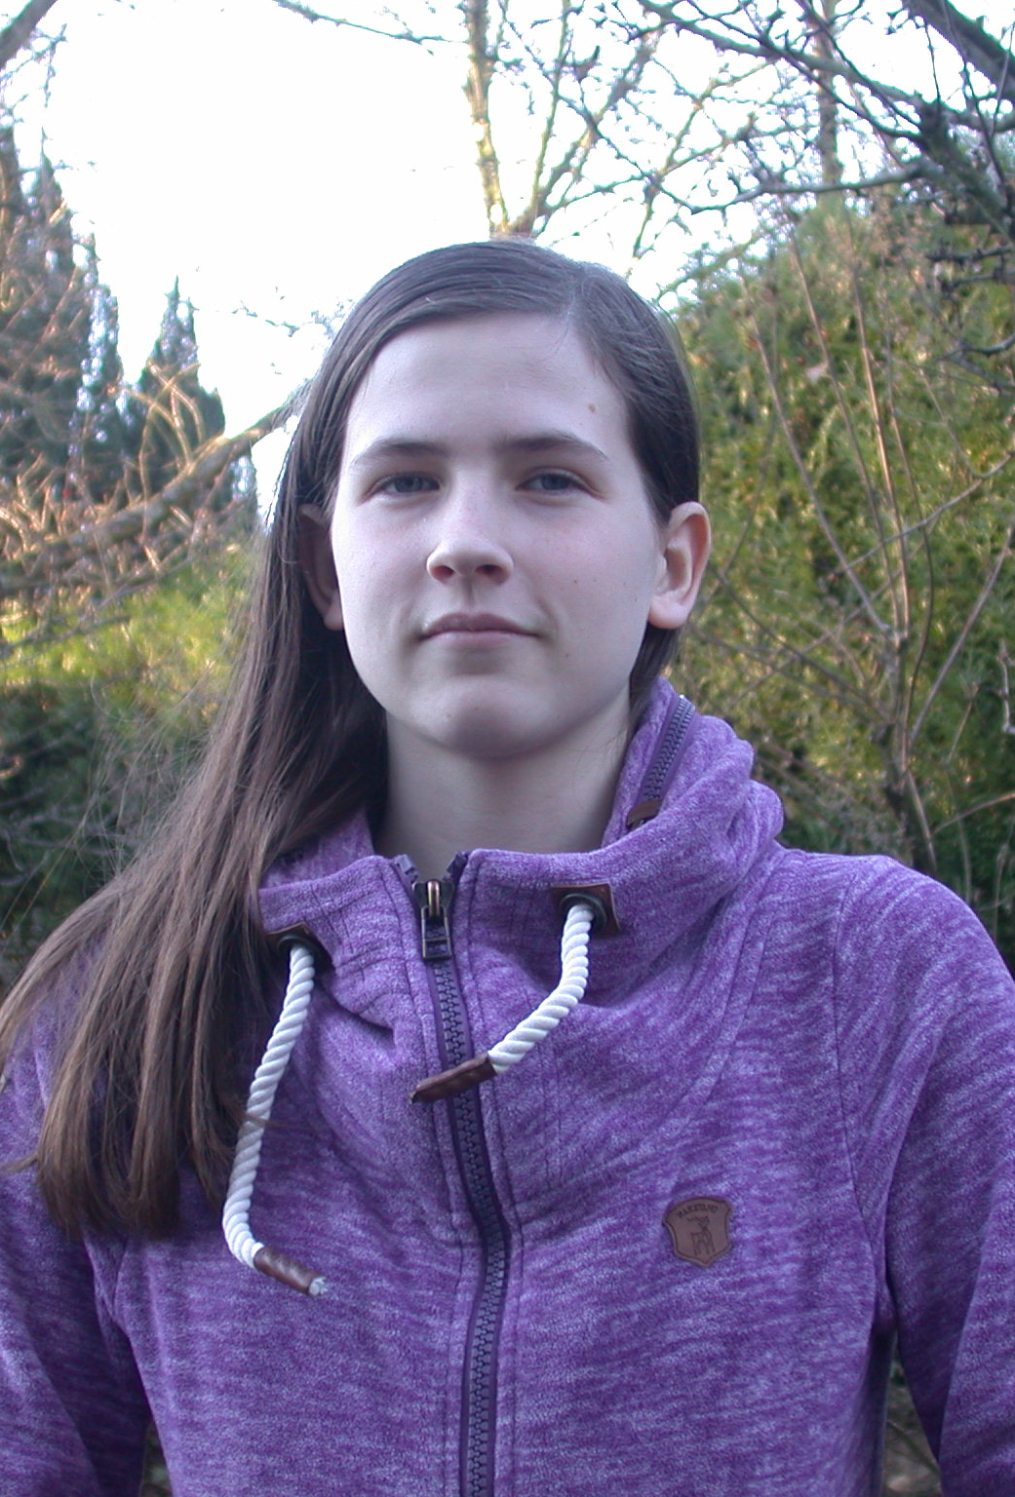
Cornelia Boeger
20 Jahre
Frankfurt
Research Manager
Social Media Expert
Technical Consultant

Slide 8
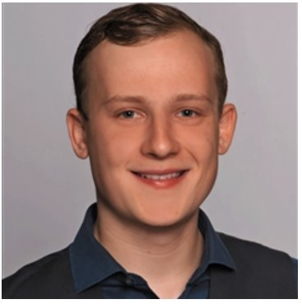
Adrian Kleinert
Quality Assurance
22 Jahre
Heddesheim
Global Marketing
Community Manager

Slide 9
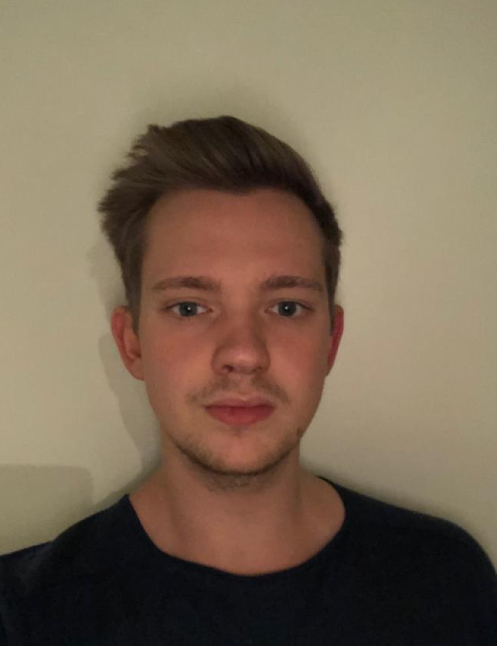
Peter Behrens
21 Jahre
Cloppenburg
SCRUM Master
Sales Consultant
Hybrid IT

Slide 10
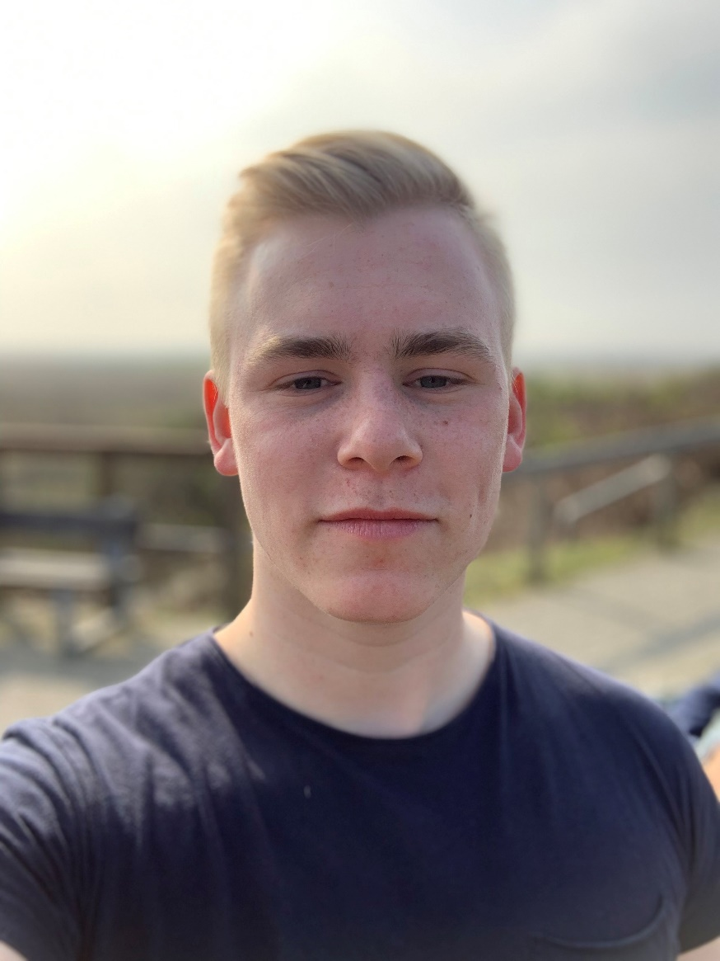
Luca StukenBorg
19 Jahre
Duisburg
Engagement Manager
Custom Solutioning
Human Ressources Expert

Slide 11
Thank You !
Your FTS Solutions Group
18.11.2019

Slide 12

FTS Solutions Group
Empower your value with IT !
18.11.2019

Slide 13

Our website
6 Mitarbeiter in über 5 Städten
FinTech Unternehmen Startup
FTS Solutions
More than 122 years of life experience

Slide 14
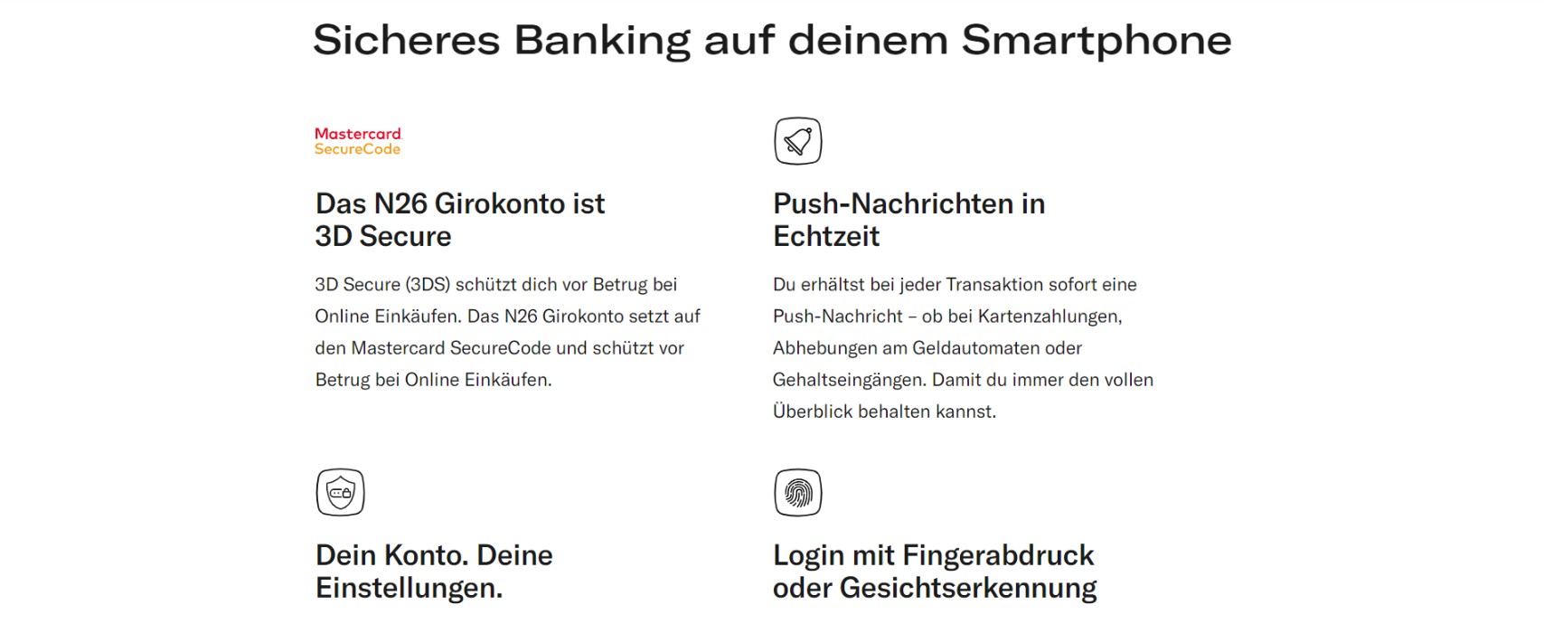

FTS
6 Mitarbeiter in über 5 Städten
FTS
FinTech Unternehmen Startup

Slide 15
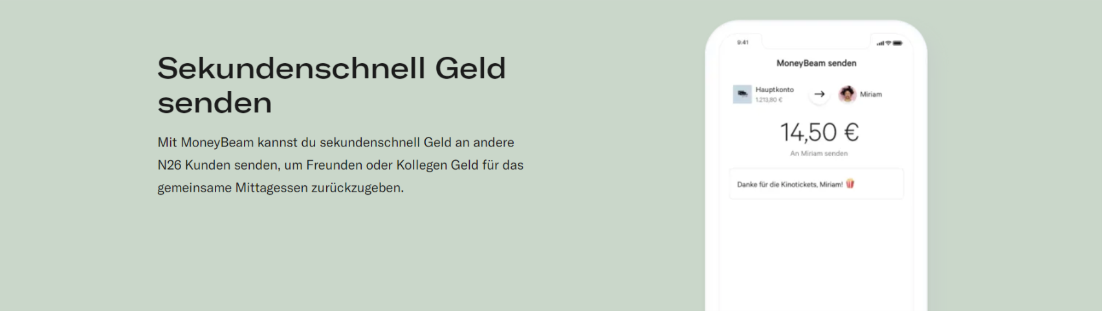
6 Mitarbeiter in über 5 Städten
FTS
FTS
„Solange es jemanden gibt, der es besser macht als du, hast du keinen Grund zufrieden zu sein.“
- FTS Solutions (2020)

Slide 16

Our solution

Slide 17
Thank You !
Your FTS Solutions Group
18.11.2019

